Slide 1
Using Anomaly Detection to Identify Credit Card Fraud
CS 5593 – Data Mining
Fall 2017
Joe Trivisonno

Slide 2
Outline
Introduction
Related Work
Proposed Work
Dataset
Algorithm
GUI
Performance
Conclusions/Future Work

Slide 3
Introduction
Credit card fraud in on the rise due to increase in credit card use
Traditional supervised methods are Neural Networks, Support Vector Machines, and Decision Trees
Data sets are extremely unbalanced
<1% of transactions are fraudulent
Difficult to train supervised models
Lack of research on unsupervised methods
Created application to perform unsupervised anomaly detection algorithm

Slide 4
Related Work
Supervised Methods for fraud detection include Neural Network, Support Vector Machines, and Decision Tress.
Neural Network is most common
Performs well on large data sets with a lot of variables
Very good at discovering irregularities within data where the relationships between variables is not well understood
“black box”
Highly dependent on preset tuning parameters
Much research in this area, so focus is on unsupervised methods

Slide 5
Related Work (cont.)
Unsupervised Methods are significantly less researched
Have been used for intrusion detection algorithms
Intrusion detection data sets are also highly unbalanced
A distance based anomaly detection algorithm using the principle components of the data has been used to successfully identify 99% of intrusions with a 1% false alarm rate,
This algorithm was adapted to identify credit card fraud for this project.

Slide 6
Proposed Work - Dataset
Credit Card fraud dataset from Kaggle.com: https://www.kaggle.com/dalpozz/creditcardfraud
Contains 284,897 transactions made by European card holders over two days in September 2013.
492 transactions (0.172%) fraudulent
Dataset contains the principle components of the original features due to confidentiality concerns.

Slide 7
Dataset Description
Column Name | Description
Time | Time (s) since 1st transaction in dataset
V1 | 1st Principle Component
V2 | 2nd Principle Component
V3 | 3rd Principle Component
V4 | 4th Principle Component
V5 | 5th Principle Component
V6 | 6th Principle Component
V7 | 7th Principle Component
V8 | 8th Principle Component
V9 | 9th Principle Component
V10 | 10th Principle Component
V11 | 11th Principle Component
V12 | 12th Principle Component
V13 | 13th Principle Component
V14 | 14th Principle Component
V15 | 15th Principle Component
V16 | 16th Principle Component
V17 | 17th Principle Component
V18 | 18th Principle Component
V19 | 19th Principle Component
V20 | 20th Principle Component
V21 | 21st Principle Component
V22 | 22nd Principle Component
V23 | 23rd Principle Component
V24 | 24th Principle Component
V25 | 25th Principle Component
V26 | 26th Principle Component
V27 | 27th Principle Component
V28 | 28th Principle Component
Amount | Transaction Amount
Class | Fraud (1) or Legitimate (0)
 | Time | V1 | V2 | V3 | V4 | V5 | V6 | V7 | V8 | V9
1 | 0 | -1.35981 | -0.07278 | 2.536347 | 1.378155 | -0.33832 | 0.462388 | 0.239599 | 0.098698 | 0.363787
2 | 0 | 1.191857 | 0.266151 | 0.16648 | 0.448154 | 0.060018 | -0.08236 | -0.0788 | 0.085102 | -0.25543
V10 | V11 | V12 | V13 | V14 | V15 | V16 | V17 | V18 | V19 | V20
0.090794 | -0.5516 | -0.6178 | -0.99139 | -0.31117 | 1.468177 | -0.4704 | 0.207971 | 0.025791 | 0.403993 | 0.251412
-0.16697 | 1.612727 | 1.065235 | 0.489095 | -0.14377 | 0.635558 | 0.463917 | -0.1148 | -0.18336 | -0.14578 | -0.06908
V21 | V22 | V23 | V24 | V25 | V26 | V27 | V28 | Amount | Class
-0.01831 | 0.277838 | -0.11047 | 0.066928 | 0.128539 | -0.18911 | 0.133558 | -0.02105 | 149.62 | 0
-0.22578 | -0.63867 | 0.101288 | -0.33985 | 0.16717 | 0.125895 | -0.00898 | 0.014724 | 2.69 | 0

Slide 8
Proposed Work - Algorithm
Unsupervised anomaly detection algorithm
Creates two functions of principal component scores
One from major components
One from minor components
Major components account for approximately 50% of the variance of the dataset
Minor components are the remaining components whose eigenvalues are less than 0.20

Slide 9
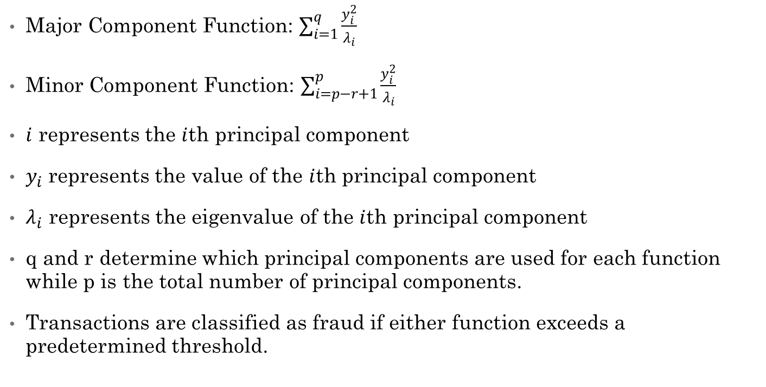
Proposed Work - Algorithm
Major Component Function: $\sum_{i=1}^{q}{\frac{y_{i}^{2}}{λ_{i}}}$
Minor Component Function: $\sum_{i=p−r+1}^{p}{\frac{y_{i}^{2}}{λ_{i}}}$
$i$ represents the $i$th principal component
$y_{i }$represents the value of the $i$th principal component
$λ_{i}$ represents the eigenvalue of the $i$th principal component
q and r determine which principal components are used for each function while p is the total number of principal components.
Transactions are classified as fraud if either function exceeds a predetermined threshold.

Slide 10
Proposed Work - GUI
GUI created with R Shiny
Instructions:
Upon startup, user uploads data set
The dataset is displayed in the “Data” tab.
User selects which columns to include for each function
User presses the “Run” button
After the algorithm is run, the transaction identified as fraudulent are displayed in the “Anomalies” tab.

Slide 11
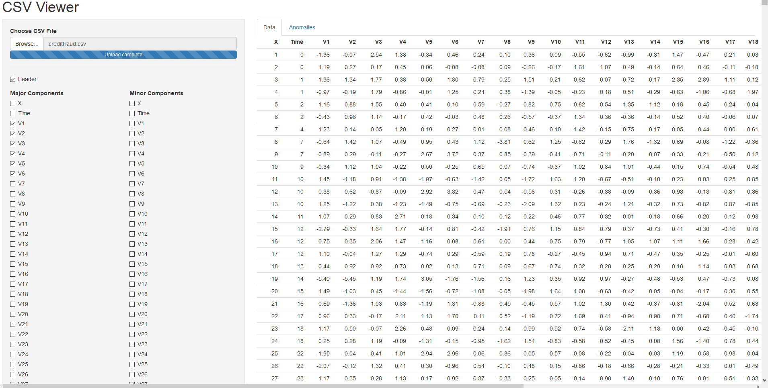
GUI – The Data Tab

Slide 12
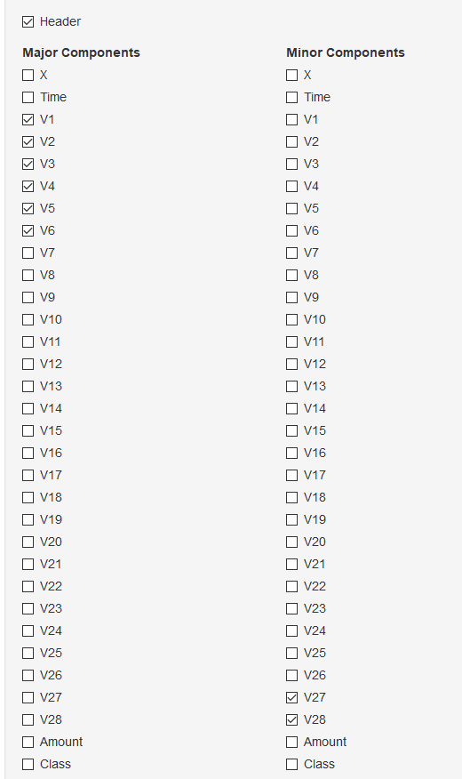
GUI – Selection Panel

Slide 13
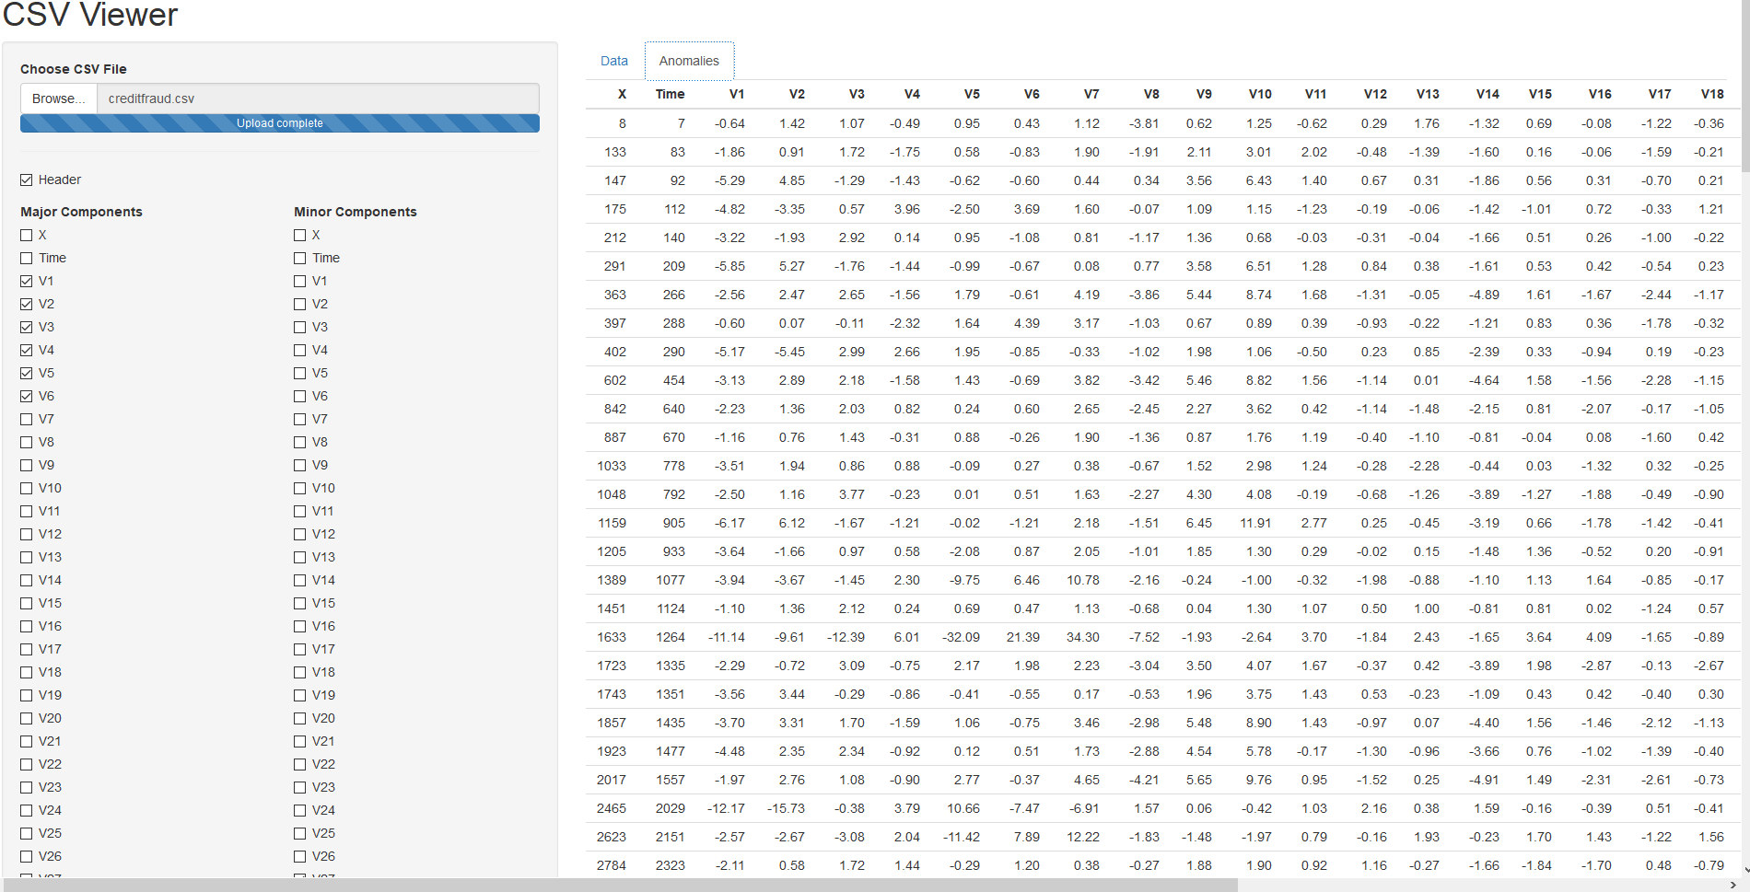
GUI – The Anomalies Tab

Slide 14
Performance
Due to imbalance, traditional performance measures not sufficient
False positives are not a big deal
Sensitivity is most important metric
Aim to identify approximately 1% of transactions as fraudulent
To achieve this, threshold for major algorithm set to 100 and threshold for minor algorithm set to 40.
Algorithm correctly identified 130 of 492 (26.42%) fraudulent transactions
Correctly identified transactions worth $10,340 of $60,127.97 in total fraudulent purchases.

Slide 15
Conclusions
While this algorithm only identifies 26.42% of fraudulent transactions, it is still useful as a tool to prevent credit card fraud
High amount of false positives are not a concern if implemented in real time
Customer can confirm purchase and carry on with day
Wont stop all fraud, but can limit impact
If used in real time in conjunction with slower but more accurate supervised models to detect fraud after it has occurred, can reduce impact even further.

Slide 16
Future Work
Algorithm and Interface can be improved
Application runs very slow – opportunities to optimize for better performance
Opportunities to incorporate additional algorithms into application
Neural Network, SVM, etc.

